Slide 1
Networking in python

Slide 2
AGENDA
Introduction to Networking in Python
What is Networking?
Python and Networking
What is SYN FLOOD?
How to make SYN Flooding in python?
How does the SYN Flood work?
Conclusion

Slide 3
Introduction to networking in python
Welcome to the world of networking in Python! In this presentation, we will explore how Python can be used for networking tasks. Networking is an essential part of computer science, and Python provides a powerful and flexible platform for building networked applications.
Python's simplicity and ease of use make it an ideal choice for networking tasks. Whether you're building a simple client-server application or a complex distributed system, Python has the tools and libraries you need to get the job done quickly and efficiently.

Slide 4
What is Networking?
Networking is the practice of connecting devices together to share resources and information. In computer science, networking refers to the communication between two or more computer systems. It involves the use of protocols, which are a set of rules that govern the communication between devices.
Networking has become an essential part of modern computing, enabling us to connect with people and resources from all around the world. For example, the internet is a vast network of interconnected devices that allows us to access information and communicate with others instantly. Without networking, we wouldn't be able to send emails, browse websites, or stream videos.

Slide 5
Python and Networking
Python and Networking
Python is a versatile programming language that can be used for a wide range of tasks, including networking. It offers a number of advantages over other languages when it comes to networking tasks.
For one, Python has a large and active community of developers who have created a variety of networking libraries and modules. These libraries make it easy to perform common networking tasks, such as sending and receiving data over the internet. Additionally, Python's simple syntax and ease of use make it an ideal choice for beginners who are just getting started with networking.

Slide 6
What is a syn flood?
A SYN flood, sometimes known as a half-open attack, is a network-tier attack that bombards a server with connection requests without responding to the corresponding acknowledgements. The large numbers of open TCP connections that result consume the server’s resources to essentially crowd out legitimate traffic, making it impossible to open new legitimate connections and difficult or impossible for the server to function correctly for authorized users who are already connected.

Slide 7
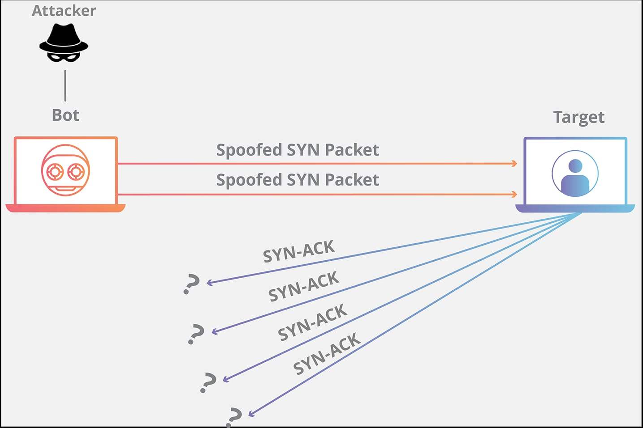
Richard Branson

Slide 8
How to make syn floding in python:
A SYN flood attack is a common form of a denial of service attack in which an attacker sends a sequence of SYN requests to the target system (can be a router, firewall, Intrusion Prevention Systems (IPS), etc.) in order to consume its resources, preventing legitimate clients from establishing a regular connection.
TCP SYN flood exploits the first part of the TCP three-way handshake, and since every connection using the TCP protocol requires it, this attack proves to be dangerous and can take down several network components.
To understand SYN flood, we first need to talk about the TCP three-way handshake:
The client requests a connection by sending a SYN message to the server.
The server responds with a SYN-ACK message (acknowledges the request).
The client responds back with an ACK, and then the connection is started.

Slide 9
How does syn flooding work?
Every client-server conversation begins with a standardized three-way handshake. The client sends a SYN packet, the server responds with a SYN-ACK, and the TCP connection is established. In a SYN flood attack, the client sends overwhelming numbers of SYN requests and intentionally never responds to the server’s SYN-ACK messages.
This leaves the server with open connections awaiting further communication from the client. Each is tracked in the server’s TCP connection table, eventually filling the table and blocking any more connection attempts from any source. Loss of business continuity and data access result.
SYN floods are frequently performed by bots connecting from spoofed IP addresses to make attack it harder to identify and mitigate the attack. Botnets can launch SYN floods as distributed denial-of-service (DDoS) attacks.

Slide 10
THANK YOU

